Slide 1

Stock price forecasting
By:
Priyanga

Slide 2

INTRODUCTION:
Stock market forecasting is a major exertion in the field of finance and establishing business.
Stock market forecasters focus on developing a successful approach for forecasting or predicting index value of stock prices.
Forecasting stock indices is very difficult because the market indices are highly fluctuating as result of increase or decrease that characterize the stock price.
Autoregressive integrated moving average (ARIMA) model has remained the mostly widely used time series model for forecasting stock market .
To build the stock price forecasting model, we will using real time TCS dataset.

Slide 3
PROBLEM STAEMENT:
In this project, we will use time series forecasting to predict the price of TCS stock for the next few years. We will use historical data of TCS stock prices, and a variety of time series forecasting models. We will then evaluate the accuracy of our forecasts, and discuss the implications of our findings for investors depends on.
The overall economic conditions
The company's performance

Slide 4
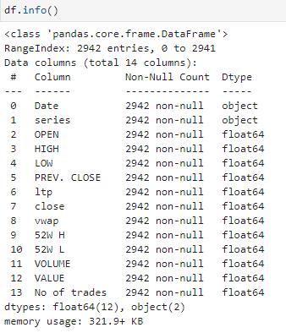
Exploratory Data Analysis:
The output of the df.info() method can be
helpful for understanding the structure of the
Data Frame and the data types of the columns.
This information can be useful for performing
data analysis and visualization.

Slide 5
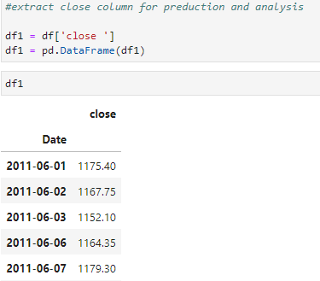
Extract Required column:
The close prices variable will now contain
a Series object with the close prices.
The Series object will have the same
index as the Data Frame.

Slide 6
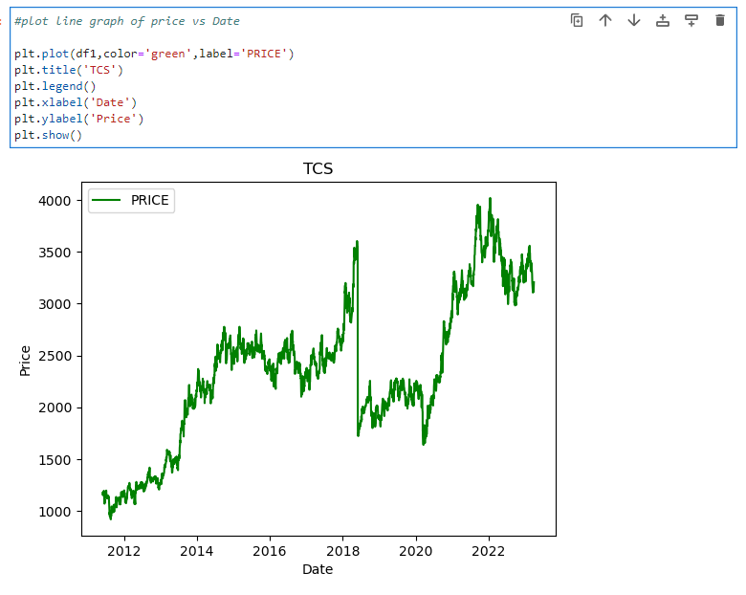
Line Graph Analysis
Identify trend
Identify patterns

Slide 7
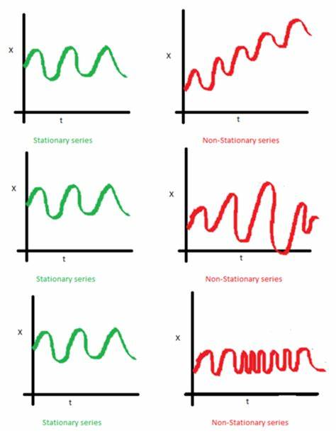
ARIMA MODEL:
Automated Regressive Integrated Moving Average.
It is actually a class of models that ‘explains’ a given time series based on its own past values, that is, its own lags and the lagged forecast errors, so that equation can be used to forecast future values.
An ARIMA model is characterized by 3 terms: p, d, q.
p is the order of the AR term
q is the order of the MA term
d is the number of differencing required to make the time series stationary

Slide 8
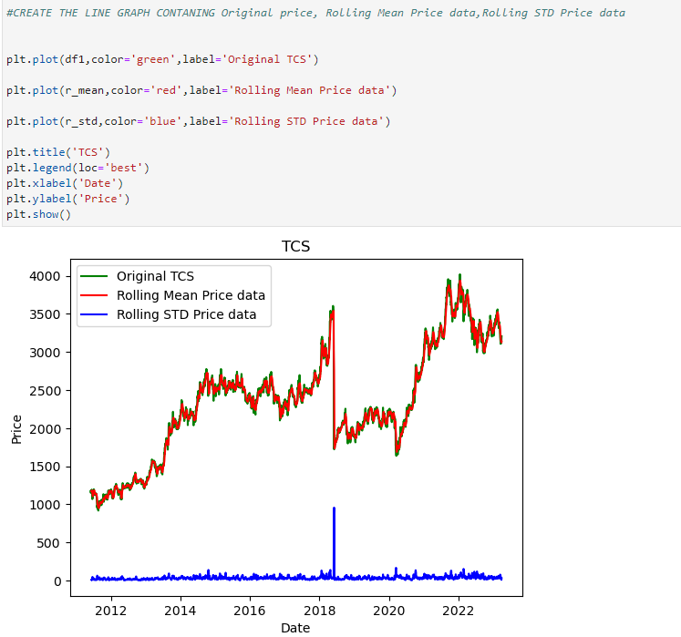
TREND ANALYSIS:
The stability of the model over time. A common time-series model assumption is that the coefficients are constant with respect to time. Checking for instability amounts to examining whether the coefficients are time-invariant.
The forecast accuracy of the model.

Slide 9
ADF:
s.no | values | metrics
0 | -2.058209 | test statistics
1 | 0.261648 | P Values
2 | 0.000000 | No. of Lags Used
3 | 2941.000000 | No. of Observation used
4 | -3.432575 | Critical Value 1%
5 | -2.862523 | Critical Value 5%
6 | -2.567293 | Critical Value 10%
from statsmodels.tsa.stattools import adfuller
ad_ft=ad fuller(df1,autolag='AIC’)
The provided code appears to be performing an
Augmented Dickey Fuller (ADF) test on a time series data.
The ADF test is commonly used to
Determine if a time series is stationary or not.

Slide 10
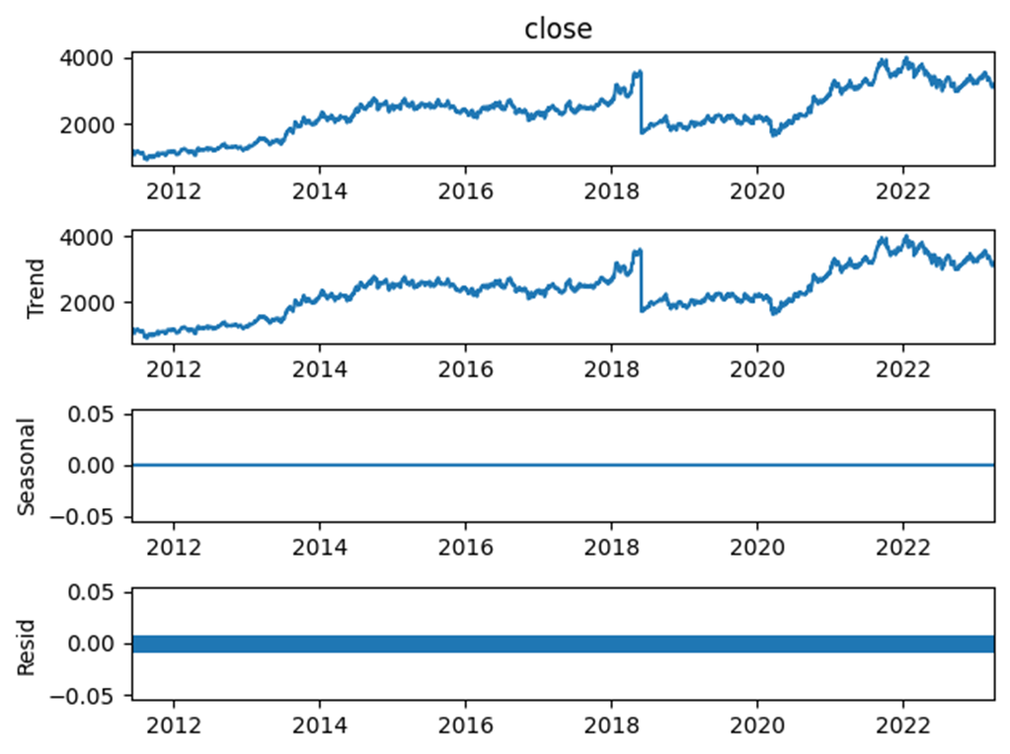
Seasonal decompose:
from statsmodels.tsa.seasonal import seasonal_decompose
decompose_df=seasonal_decompose(df1['close'],model='additive',period=12)
decompose_df.plot()
plt.show()
POLYNOMIAL REGRESSION:
Polynomial regression is a technique we cause to fit a regression model when the relationship between the predictor variable(s) and the response variable is nonlinear.

Slide 11
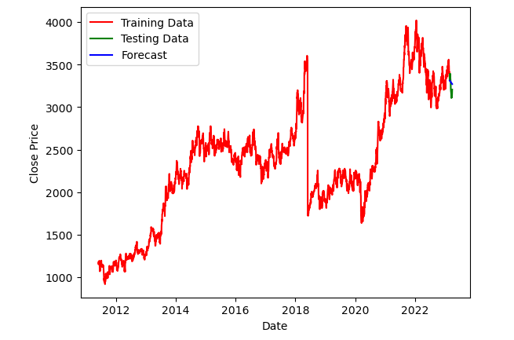
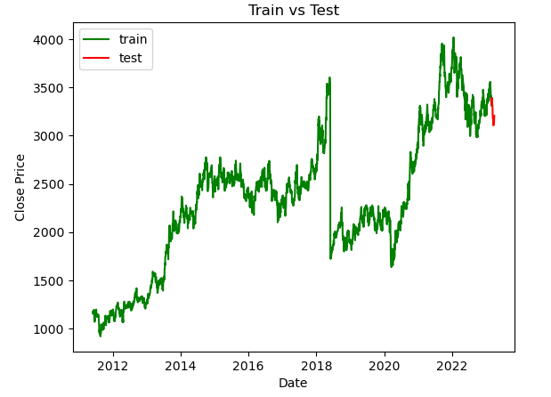
GRAPHS ANALYSIS:
TRAIN VS TEST
FORECASTING

Slide 12
INFERENCES:
We have drawn some inferences from the data frame. Here is a summary of a few of them:
Today we are all connected with digital and every In all seasons, supermarkets should be aware of customer demand and avoid
stockouts. This project focus on predicting the future demand of sales using various machine learning algorithms.
Analyzing the past sales of the store
Understanding the factors that affect the sales of a store
Deriving inferences related to those sales
Predicting the future sales from the inferences derived
Help the businesses stock up/stock down products accordingly

Slide 13
THANK YOU

